Slide 1
EPA’s Roadmap for the Second Planning Period
The roadmap outlines the implementation tools and guidance products that EPA will release to help states during their 2021 SIP development.
Timeline for implementation tools outlined in the roadmap:
Fall 2018 – Final recommendations on tracking visibility progress for the second implementation period, including methods for adjusting the glidepath.
Summer 2019 – Updated, as necessary, natural visibility conditions estimates.
Summer 2019 – Updated 2028 visibility modeling, including estimates of US and international source contributions for Class I Areas.
Summer 2019 – Final guidance on regional haze SIP development will focus on topics such as:
Additional information and context regarding selection of sources for in-depth analysis, including relevance of previous decisions to adopt emission controls to meet other CAA requirements.
Consideration of visibility benefits along with the four statutory factors.
Rulemaking: EPA is exploring further regulatory changes to impact future planning periods.

Slide 2
Technical Guidance on Tracking Visibility Progress
In December 2018, EPA released “Technical Guidance on Tracking Visibility Progress for the Second Implementation Period of the Regional Haze Rule” (https://www.epa.gov/visibility/technical-guidance-tracking-visibility-progress-second-implementation-period-regional)
The 2017 Regional Haze Rule revisions require a revised approach to tracking visibility improvements over time.
The guidance finalizes a recommended methodology to develop baseline and current visibility conditions, and natural conditions on the 20% most impaired and clearest days at Class I areas.
The recommended visibility tracking metric focuses on anthropogenic visibility impairment

Slide 3
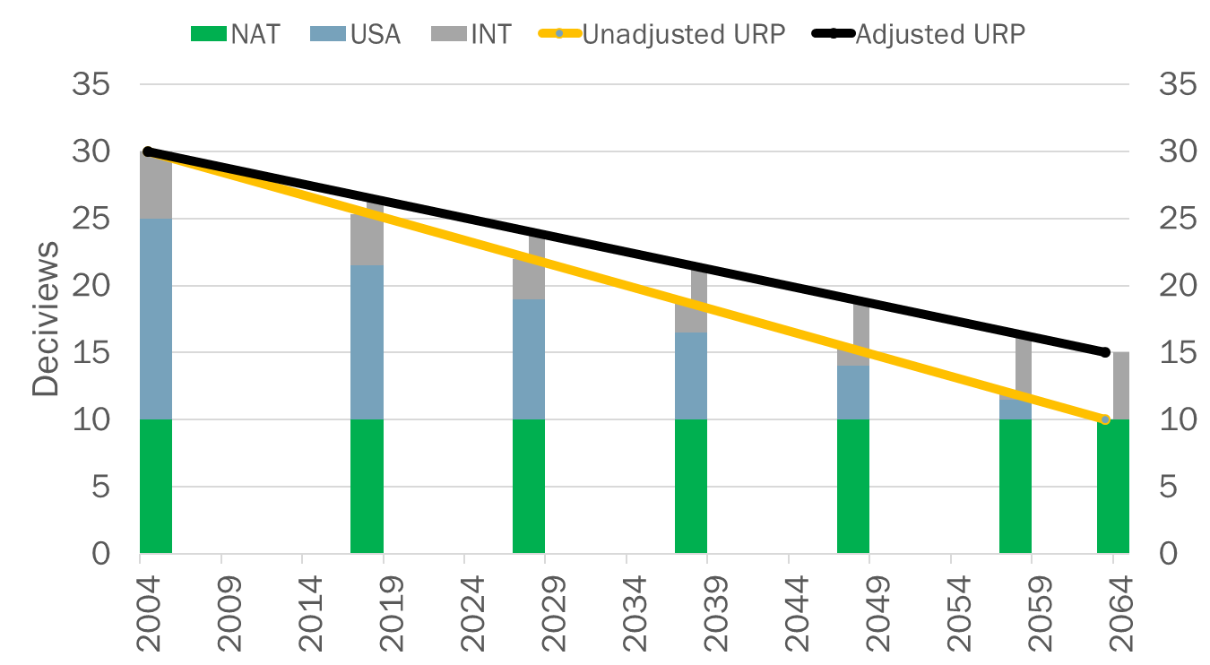
International Adjustment
The 2017 RHR allows states to adjust the endpoint of the URP glidepath upwards to account for international anthropogenic impacts (and prescribed fires)
The tracking guidance provides technical information, and recommendations on procedures and considerations for making URP adjustments
Year selection for quantifying international visibility impacts
Modeling to estimate anthropogenic international impacts
Recommended types of models
Modeling techniques
Additional considerations

Slide 4
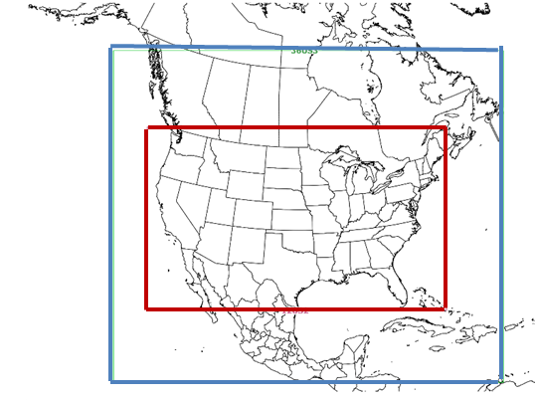
Updated EPA Regional Haze Modeling- Summer 2019
New 2016 based modeling platform with emissions projections to 2028, including sector-based PM source apportionment
2028 projected deciviews and glidepath estimates at Class I areas
Estimate of international anthropogenic contributions
Model Improvements
New 2016 and 2028 emissions from the State/EPA platform collaborative
Regional model improvements
Technical updates to CAMx
Larger regional domain (including 36km outer domain)
Updated international boundary conditions
Hemispheric CMAQ
Modeling will be completed by the end of the summer 2019

Slide 5
Modeling Deliverables
2028 default glidepath projections for Class I areas
International anthropogenic and prescribed fire contribution estimates
Calculation of international contributions
Issues and lessons learned
2028 national sector-based contributions
22 national emissions sectors (EGUs, on-road mobile, oil and gas, commercial marine, wildfires, etc.)
Public documentation by the end of the summer
Including caveats and recommendations for further improvements
National and/or region specific calls/webinars to discuss modeling and how it can be useful to air agencies.
National regional haze workshop (October 28th-30th )

